Slide 1
Character Writing Robot
TEAM 6
Team Details :
Amarjit Prasad (BE-EXTC)
Abhishek Kharche (BE-COMP)
Chinmay Pednekar (BE-COMP)
Vaibhav Naidu (BE-COMP)
SHIVAJIRAO S. JONDHALE COLLEGE OF ENGINEERING
DOMBIVLI

Slide 2
Index
Project objective
Task specifications
Project plan
Flow Chart
Project virtual demonstration
Technical challenges
Hardware requirements

Slide 3
Project objective
The project objective is to explore the capabilities of robotics
We program a robot to write on a paper with pen using Spark programming board
Taking the input character from keyboard through wireless communication
A mechanism makes the pen move in different directions
Make the mechanism can draw curves and slant lines

Slide 4
Task Specifications
Making a robust robot body to hold the mechanism
Placing the pen at the centre of mechanism and attaching a puller on top of it
Character printing through STROKE method, using line coordinates passed from the PC
Input can be sent by the keyboard through Zigbee module
When finished printing one character lift the pen and move to next position

Slide 5
Project Plan
Work division :
Name | Mechanism and Robot body | Algorithm and Coding | Wireless communication | Documentation
Chinmay Pednekar
Abhishek Kharche
Vaibhav Naidu
Amarjit Prasad

Slide 6
Project Plan
Work Division :
Task | Date of completion
Project topic selection | 3rd Oct 2011
Designing of mechanism and robot body | 31st Oct 2011
Implementation of mechanism | 30th Nov 2011
Studying algorithm | 15th Jan 2012
Coding | 15th Feb 2012
Testing and debugging | 9th Mar 2012
Documentation | 31st Mar 2012

Slide 7
Start
Flow Chart
Take next character from input string
Load line coordinates from memory
Proceed to start point and put pen down
Trace inbuilt path to final point and lift the pen
No
All lines of current alphabet traced ?
Yes
Move robot to next position
No
All characters in input string printed ?
Yes
Stop

Slide 8
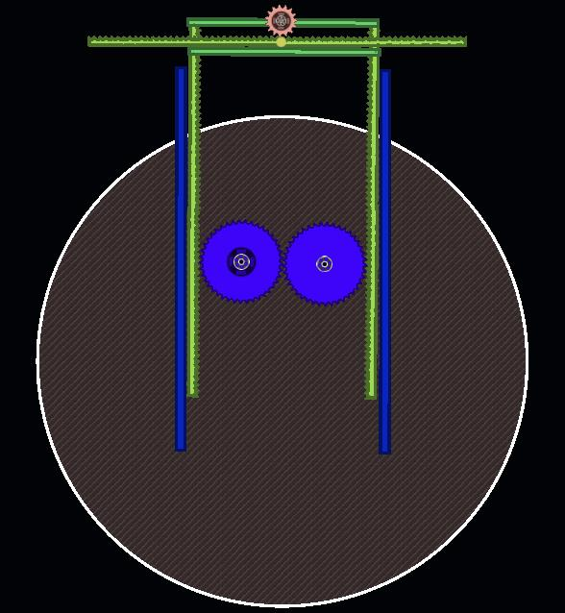
Virtual Demonstration
Rack and Pinion arrangement
RC Servo motor
Robot body

Slide 9
Technical challenges
Making subroutines for each character
Algorithm selection and study
Cannot use Gripper, as it is too heavy to install
Designing the mechanism to move the pen
Precision for writing curved alphabets
Taking input through keyboard using ZigBee
Making the robot body
Making pen up-down mechanism

Slide 10
Hardware Requirements
Spark/FireBird Robot (ATMEGA2560)
Mini RC Servo motor (3 Nos)
Material for Rack and Pinion arrangement
Zigbee Module (2 Nos)
Chassis
DC Motors with position encoders (4 Nos)
Wheels (4 Nos)
Caster wheels

Slide 11
Thank You

